Slide 1
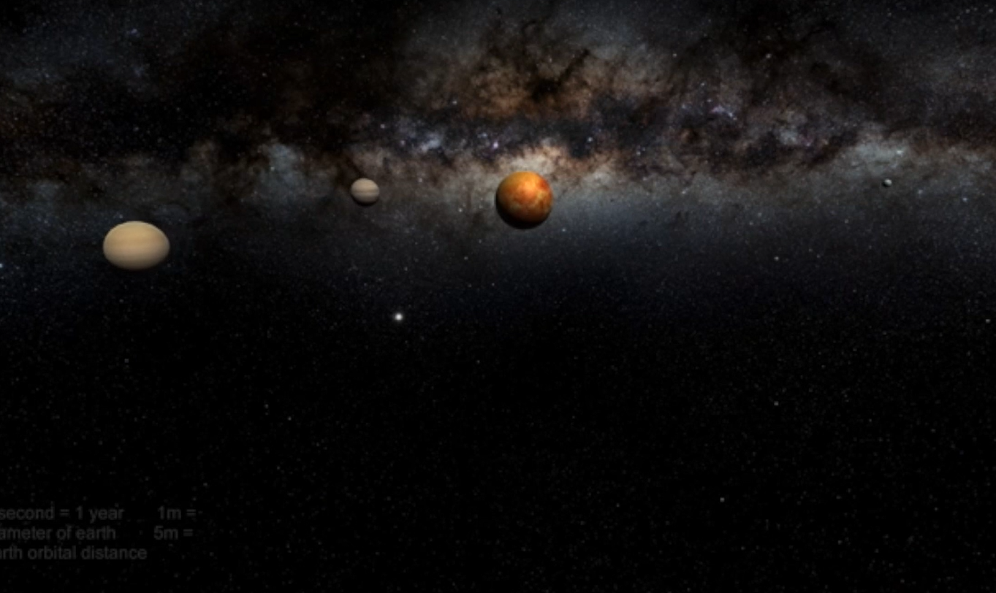
Solar Sounds
Sonify Space for Fun and Profit
Open Data for All
Amelia, Bengi, James, Jasmin, Serena, and Trevor

Slide 2
Open data is collected and interpreted in many ways. Could sound help give a feel for the data?
We looked at 3 different ways to create sound from open data collected by NASA and other Space Agencies
A scratch based program to scan images of the sun’s surface and produce sounds based on it
A Unity 3D model of the solar system with sounds giving information about planets orbits and distance with some solar wind information
A sonic Histogram using 52 notes to indicate the distribution of brightness on a solar image.

